Slide 1
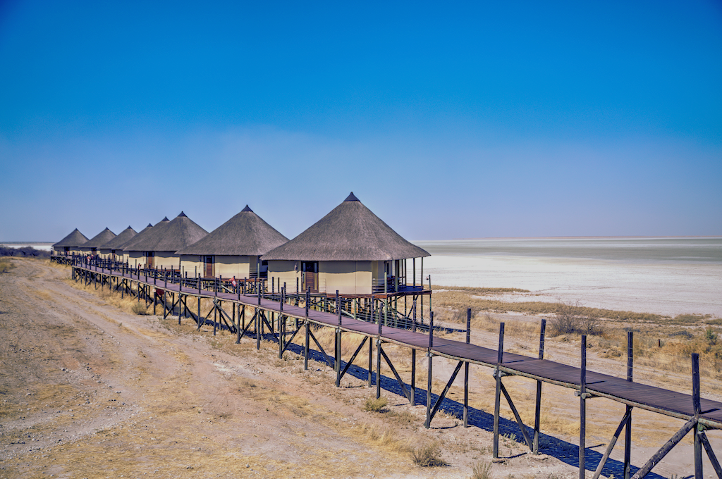


WWHTTPS://WWW.NAMIBIATHATCHING.COM/ABOUT.PHP
COMPANY PROFILE
AFRO - THATCH CC

Slide 2
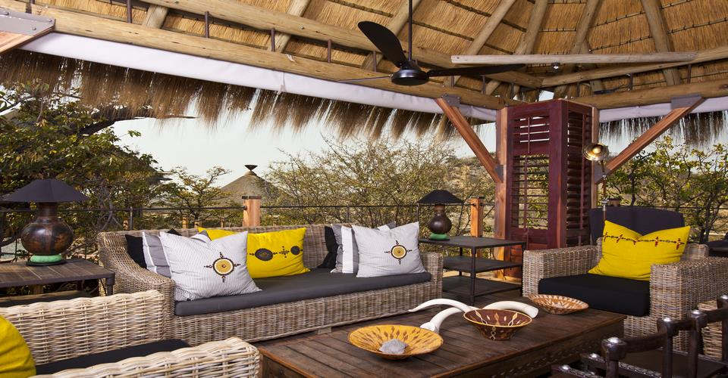
COMPANY BACKGROUND:
Afro-Thatch is a proudly Namibian established company by visionary individuals who recognized the intrinsic value of nature in shaping the tapestry of national tourism and hospitality. Our journey began in the early days of 2009 with a dedicated focus on a specific target market. Over time, our commitment to excellence and a passion for preserving the essence of Africa in construction led us to expand our horizons and enhance our business efficiency.
AFRO THATCH CC

Slide 3
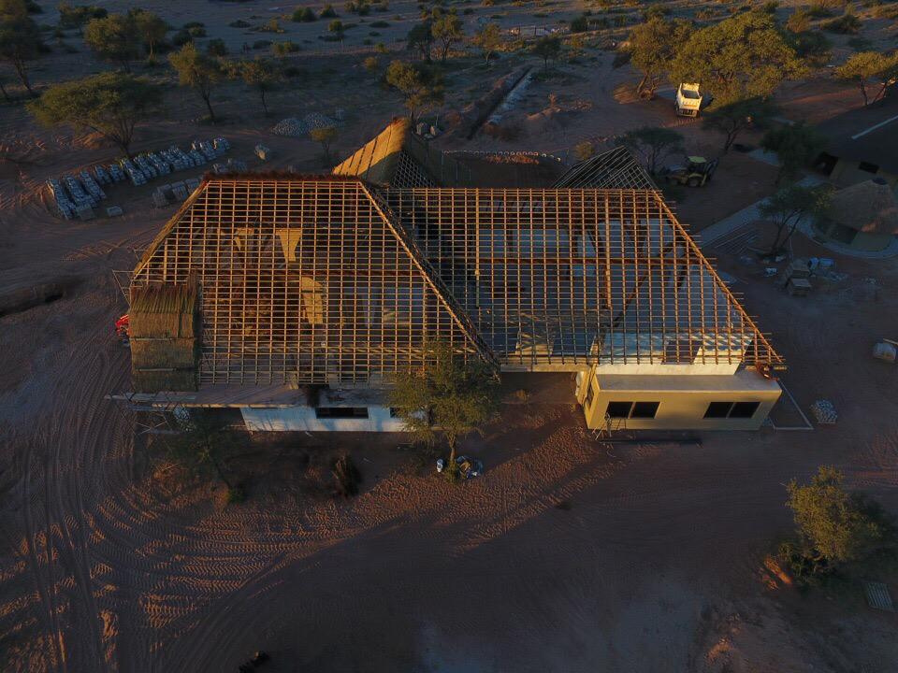
OUR VISION
OUR HISTORY
At Afro-Thatch CC, we envision a harmonious blend of contemporary luxury and traditional African aesthetics. We aspire to be the cornerstone of the African construction industry, setting the standard for innovation, quality, and eco-consciousness.

Slide 4
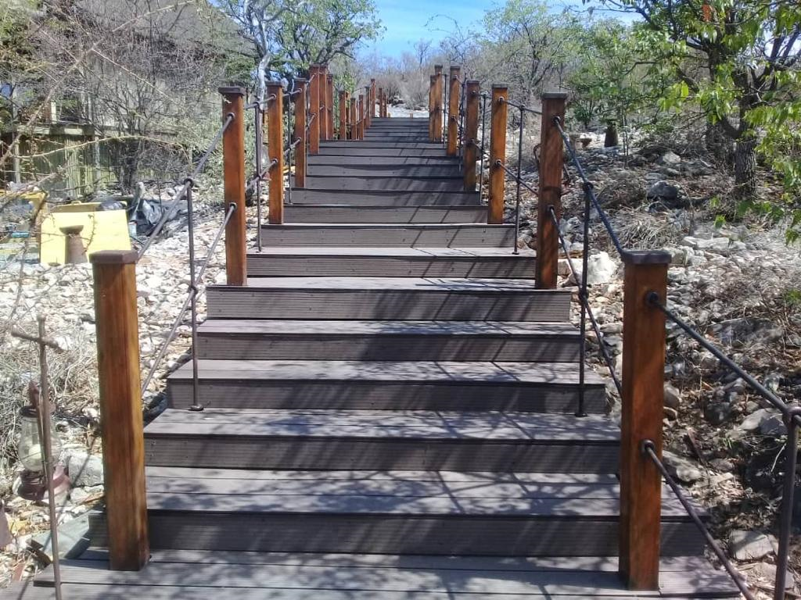
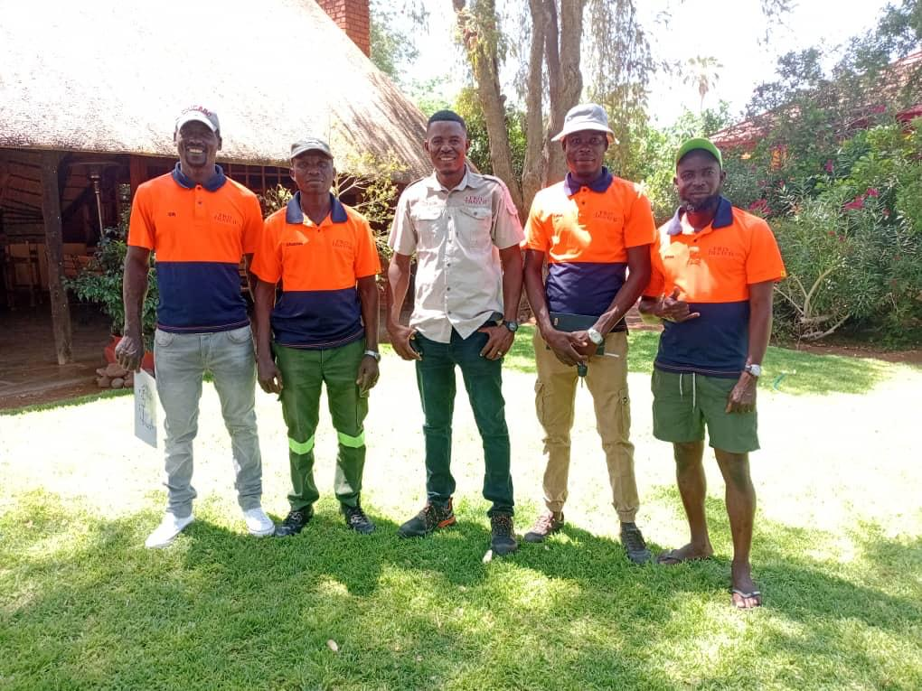
MEET OUR TEAM
Led by Mr. Sinclair Mkandla (Centre),Afro-Thatch embodies a philosophy rooted in reverence for nature, cultural heritage, and the artistry of construction. We believe that our work contributes not only to the beauty of structures but also to the enrichment of experiences for those who inhabit them.
a

Slide 5
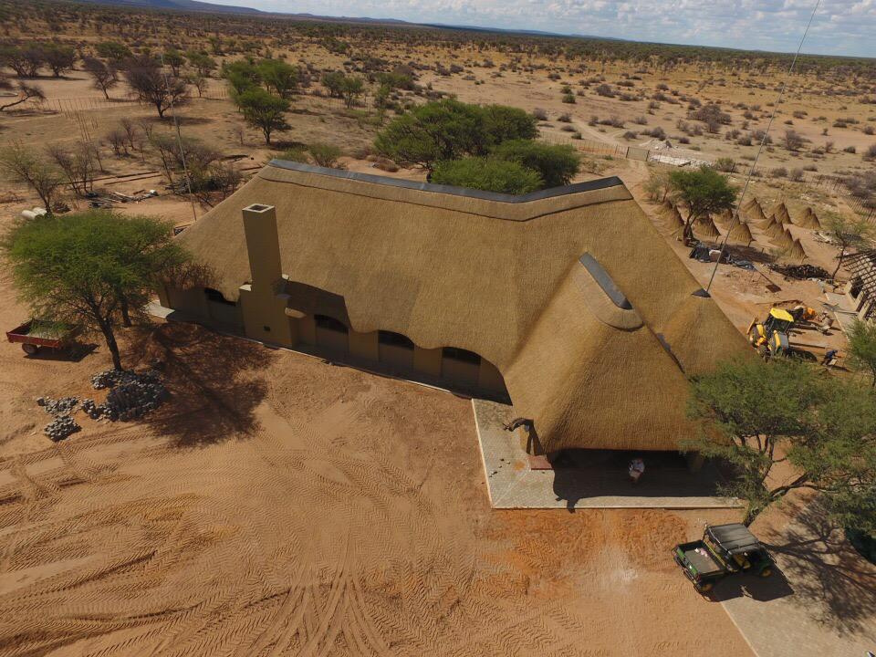
OUR EXPERTISE
With a team of seasoned artisans and contractors, Afro-Thatch CC brings a wealth of expertise to every project. We understand the profound connection between design, environment, and culture, and we tailor our solutions to transform visions into captivating realities.

Slide 6
SERVICES OFFERED:
3. Roof Repair and Reconfiguration:
At Afro Thatch, we understand the importance of keeping your thatched roofs in pristine condition. Our team excels in roof repairs and reconfigurations, giving your structure a fresh, inviting look and feel.
4. After-Sales Service:
Customer satisfaction is paramount to us. We provide comprehensive after-sales services to ensure that all customer requirements have been met. Our commitment doesn't end with construction; it continues throughout the life of the project.
1. Construction of Roofs with Poles:
Afro Thatch specializes in the construction of sturdy, visually captivating roofs that reflect the essence of African architecture. Our use of quality materials and skilled craftsmanship ensures that your structure stands the test of time.
2. Thatching of Roofs with Grass:
We offer comprehensive thatching services, working closely with clients to bring their visions to life. Whether it's for lodges, resorts, or private residences, our thatched roofs are a testament to the time-honored art of thatching.

Slide 7
SERVICES OFFERED:
5. Personalized Planning:
We believe in a collaborative approach. Before embarking on any project, we engage with our clients to create a comprehensive plan that aligns with their vision. Our experienced staff works closely with you to ensure your needs are met and your expectations exceeded.
6. Quality Assurance:
Quality is at the core of everything we do. Our commitment to delivering high-quality work is unwavering. We take pride in our craftsmanship and ensure that each project is executed to perfection, leaving our clients delighted with the results.
7. Transformative Tile Solutions:
We specialize in the supply and installation of sand-coated tiles. Our services include the removal of thatch, allowing for the installation of tiles. Alternatively, we can install tiles directly on top of existing thatch, utilizing it as an insulator on the inside. for a seamless transformation for your space.
8. Landscape Features and decking:
Our professional services cover the installation of wooden and composite decks around pools, entertainment areas, and walkways, along with composite decking fencing. We also specialize in the precise installation of pergolas for enhanced patio experiences and artificial waterfalls to bring tranquility to your garden.

Slide 8
SERVICES OFFERED:
9. Safari Tents:
Afro-Thatch CC specializes in the construction of safari tents for lodges, resorts, and eco-tourism establishments. We provide complete solutions, including structural frameworks, flooring, decking, roofing, and finishing. Our safari tents are designed to blend seamlessly with natural environments while offering comfort, safety, and durability suitable for luxury and wilderness settings.
10. Welding:
Afro-Thatch CC provides reliable and high-quality welding services for residential, commercial, and lodge developments. Our welding solutions include structural steel work, repairs, custom metal fabrication, and on-site installations. We focus on strength, safety, and durability, ensuring all welded components meet required standards and are built to last under demanding conditions.
11. Plumbing:
We offer comprehensive plumbing services tailored to homes, lodges, resorts, and commercial properties. Our services include new installations, repairs, maintenance, and upgrades of water supply and drainage systems. Afro-Thatch CC prioritizes efficiency, functionality, and compliance, delivering plumbing solutions that support long-term performance and reliability.
12. Joinery:
Our joinery services combine craftsmanship and precision to deliver high-quality wooden structures and finishes. We specialize in custom-made doors, decking, cabinetry, roofing components, and structural woodwork. Afro-Thatch CC uses quality materials and skilled workmanship to create functional, durable, and aesthetically pleasing joinery solutions.

Slide 9
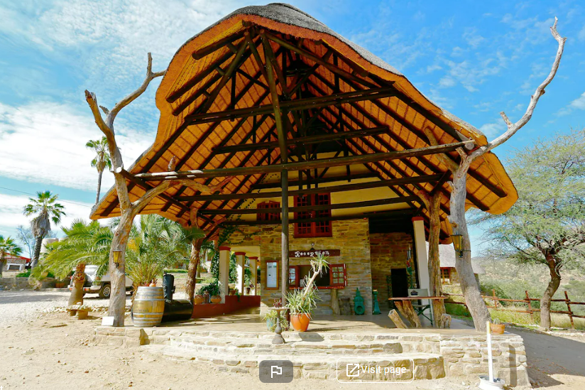
WHY CHOOSE AFRO-THATCH CC:
1.Cultural Reverence:
Our profound understanding of African cultures enables us to create thatch roofs that pay homage to the rich history and traditions of the continent.
2. Unrivaled Craftsmanship:
Our artisans are masters of their trade, blending time-honored techniques with modern innovations to deliver unmatched quality.
3. Tailored Excellence:
We don't just build roofs; we craft experiences. Each thatch roof is a unique masterpiece designed to captivate and leave a lasting impression.
4. Sustainability Stewards:
We are staunch advocates for preserving the environment and uplifting local communities, making us the preferred choice for sustainable construction projects.
5.Client-Centric Approach:
Your vision is our mission. We listen, collaborate, and execute with utmost precision to bring your dream projects to life.

Slide 10
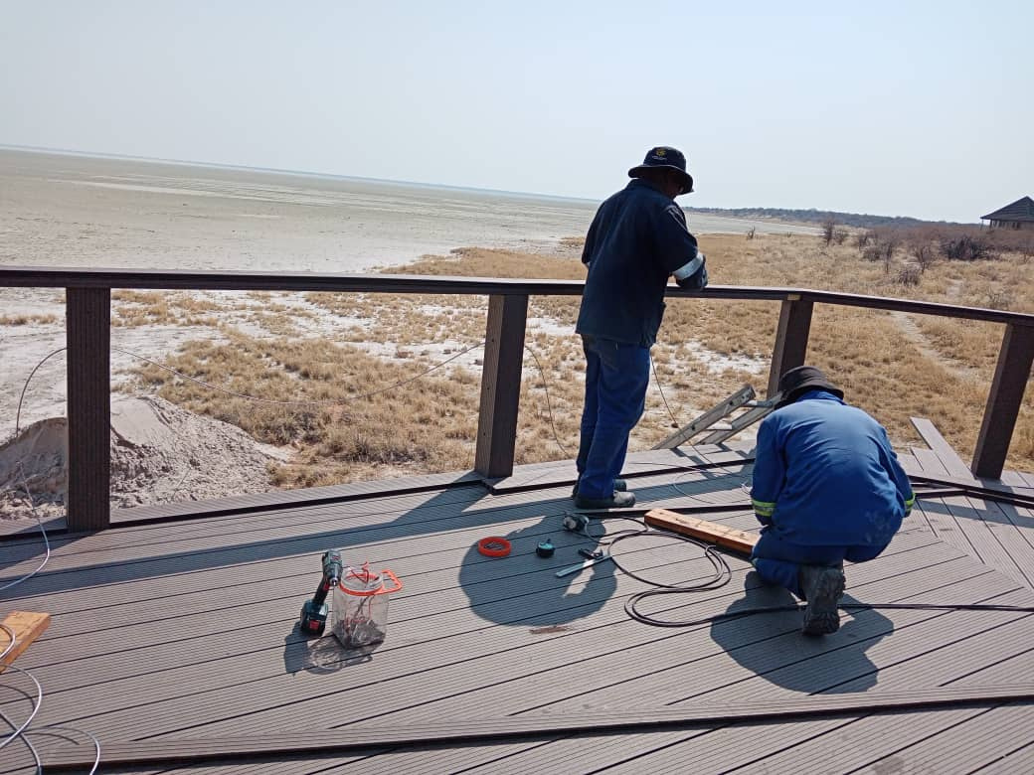
RESOURCE PLAN:
Skilled Artisans:
Our workforce comprises highly skilled artisans who have honed their craft over years of experience. They are experts in constructing, thatching, and maintaining roofs with an unparalleled level of precision and attention to detail.
Diverse Talents:
We take pride in the diversity of talents within our team. From master thatchers to construction experts, our workforce encompasses a range of expertise to handle various aspects of our projects effectively.
Continuous Training:
We invest in continuous training and development programs to keep our workforce updated with the latest industry trends, techniques, and safety protocols. This ensures that they deliver top-notch quality on every project.
Collaborative Culture:
Our company fosters a collaborative culture where every team member's ideas and insights are valued. This collaborative spirit enables us to innovate and improve our services continually.

Slide 11
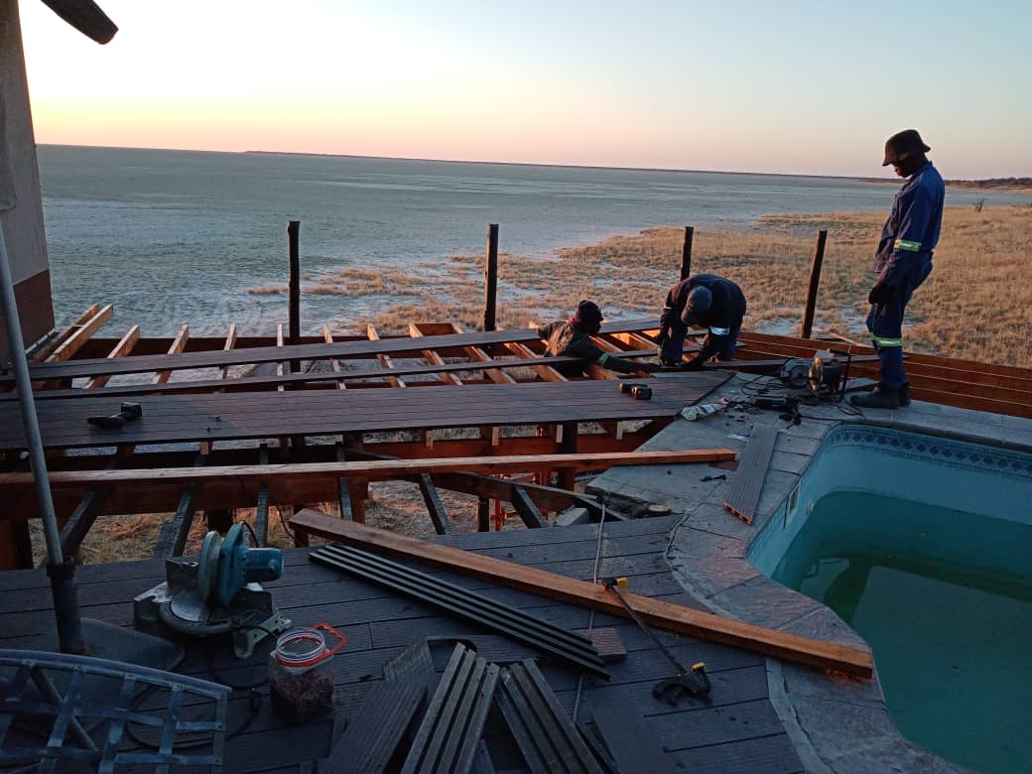
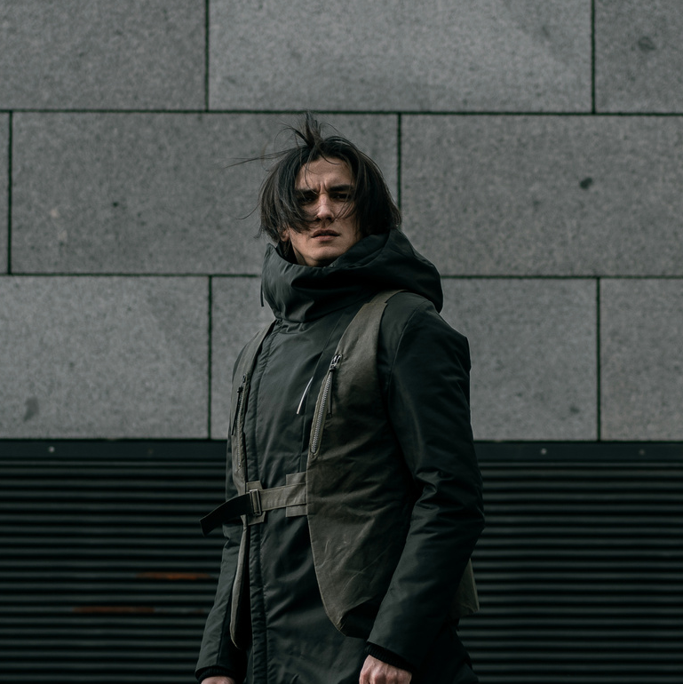
HEALTH & SAFETY PROGRAMS:
At Afro Thatch, the well-being of our workforce is a top priority. We are committed to providing a safe and healthy working environment through our comprehensive health and safety programs:
Safety Training:
Our workforce undergoes rigorous safety training to ensure they are well-prepared for the challenges of working in construction and thatching. This includes training in proper handling of materials, tools, and equipment, as well as safe construction practices.
Safety Equipment:
We equip our team with the latest safety gear and equipment, such as helmets, safety vests, gloves, and harnesses. This ensures that they can work comfortably and securely on-site.
Regular Inspections:
We conduct regular safety inspections and audits on our construction sites to identify and mitigate potential hazards. Our proactive approach to safety helps prevent accidents and injuries.
Emergency Response:
Our workforce is trained in emergency response procedures, including first aid and evacuation protocols. This preparedness ensures that they can respond effectively in case of any unforeseen incidents.
Health and Wellness:
We prioritize the physical and mental well-being of our workforce. Regular health check-ups, access to counseling services, and wellness programs are integral parts of our commitment to their health.
At Afro-Thatch, we understand that a safe and motivated workforce is essential to delivering exceptional results on every project. Our resource plan and health & safety programs reflect our dedication to our team's welfare, ensuring that they are empowered to create the finest thatched roofs while maintaining their own well-being.

Slide 12
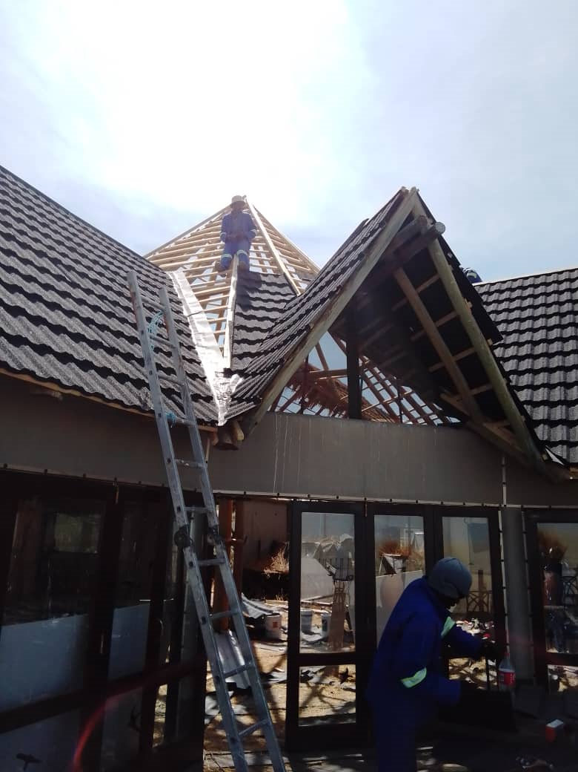
PROJECT EXPERIENCE
1. SAROA GAME LODGE:
JULY- DECEMBER 2016 & MAY AUGUST - VALUED AT N$ 2.8 MILLION
WE DID CONSTRUCTION OF BIG LAPPA, SPA, BUNGALOWS AND RESIDENTIAL HOUSE.
2.DOLOMITE CAMP NWR :
SEPTEMBER 2019- APRIL 2020 - VALUED AT N$ 3.6 MILLION
AFRO THATCH WAS SUBCONTRACTED UNDER ALKE BUILDING TO REVAMP AN OLD WOODEN DECK WITH PVC COMPOSITE DECKING, INSTALLATION OF ALUMINUM DOORS AND CANVAS.
3.GUESTFARM KIRIPOTIB :
JULY- AUGUST 2024 - VALUED AT N$ 1.4 MILLION
CONSTRUCTION OF 2 LAPPA`S & A CHAPEL.
4.ONKOSHI CAMP NWR :
SEPTEMBER 2022 - FEBRUARY 2023 - VALUED AT N$ 9 MILLION
AFRO THATCH WAS SUBCONTRACTED UNDER ALKE BUILDING TO RENEW ALL THATCH ROOFS, THEREFORE OLD THATCH MATERIAL WAS REPLACED WITH HARVEY THATCH TILES AND INSTALLATION OF CEILINGS AND RHINO BOARDS WAS COMPLETED.
5.DUESTERN BROCK FARM :
JULY- AUGUST 2022 - VALUED AT N$ 500 000
AFRO THATCH WAS CONTRACTED TO BUILD TWO LAPPAS OF DIFFERENT SCALES. THATCH ROOF STRUCTURES WERE COMPLETED IN A MONTH.

Slide 13
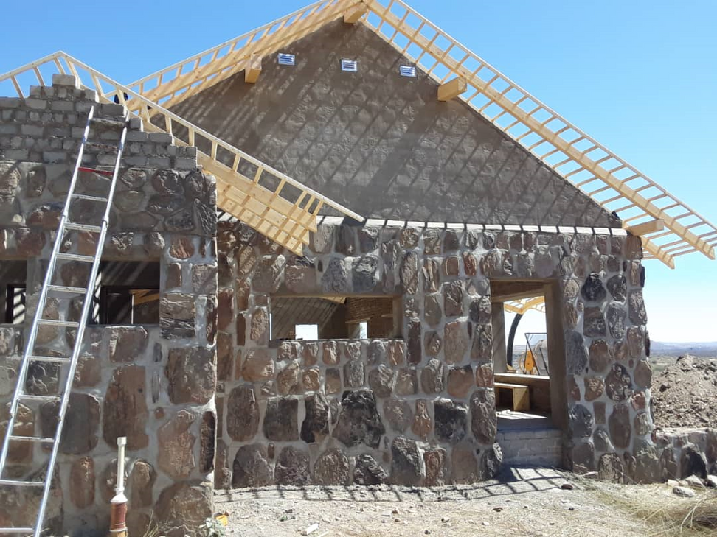
CONTACT
US
WE ARE LOOKING FORWARD TO HEARING FROM YOU.
SINCLAIR MKANDLA – MANAGING DIRECTOR
PHONE: +264 81 445 1519/+264 81 843 0684
E-MAIL 1 : SINCLAIR@NAMIBIATHATCHING.COM
E-MAIL 2 : SINCLAIRTHATCH@GMAIL.COM
WWHTTPS://WWW.NAMIBIATHATCHING.COM/ABOUT.PHP

